Slide 1
Comparison of Methods for Capturing Discontinuities
With an Introduction to GPU Programming
Sean Davis and Will Matern

Slide 2
Acknowledgements
Mentor: Dr. Bob Robey
Workshop Coordinator: Dr. Scott Runnels
Collaborator: David Nicholaeff
Thank you!

Slide 3
Outline
Motivation
Problems with capturing discontinuities
Methods implemented and tested
First order Upwind
Lax-Wendroff
Limiters
MUSCL
SUPG
Early MPDATA results
GPU Programming
Introduction
Results solving the shallow water equations
Conclusions

Slide 4
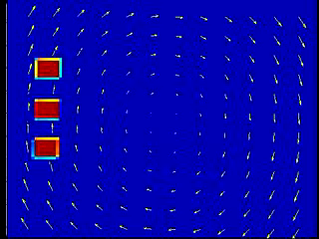
Motivation
A simple model problem showing the advection of radioactive water dumped into the ocean and carried by a rotational current across the Pacific.

Slide 5
1D Advection
We are using the 1D advection equation (in our 2D codes) to test various methods:
We are looking at the advection of 3 different types of waves
Square Wave
Triangular Wave
Exponential Smooth Wave

Slide 6
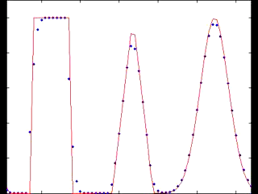
First Order Upwind Scheme
Conservative 1st order scheme
Overly dissipative

Slide 7
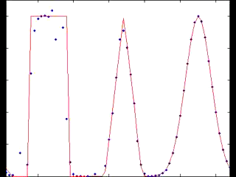
Lax-Wendroff
Conservative 2nd order scheme
Approximate solution has oscillations around sharp gradients

Slide 8
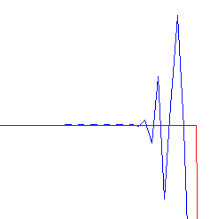
Limiters
Godunov’s Theorem – Any linear scheme above first order accurate (space) cannot be Total Variation Diminishing (TVD).
Solution: Limiters (a nonlinear scheme)
Exact Solution
Non-TVD Solution
Notes:
First order at discontinuities
Doesn’t affect the solution when it is smooth
Discuss TVD

Slide 9
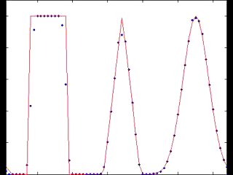
Lax-Wendroff w/ Superbee Limiter
1st order near discontinuities, 2nd order elsewhere
For linear equations is mathematically guaranteed to be TVD

Slide 10
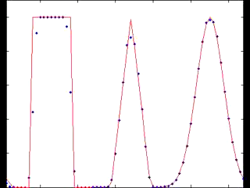
Monotone Upstream Scheme for Conservation Laws (MUSCL)
Used a modified Osher-Chakravarthy scheme
Upwind biased
Second order TVD approximation
Numerical oscillations avoided using a minmod function

Slide 11
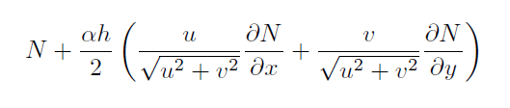
Streamline Upwind Petrov-Galerkin (SUPG)
Trial functions – a set of functions assumed to approximate the underlying solution. The trial functions have degrees of freedom that must be solved for.
Test functions – a set of functions used to solve for the degrees of freedom of the trial functions. Uses the weak formulation of the governing equation.
Petrov-Galerkin – Test functions ≠ Trial functions
SUPG – Choose test functions to be:
where N is a trial function

Slide 12
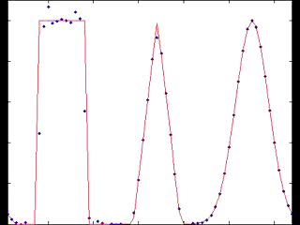
SUPG
Inspired by finite difference methods (upwinding and artificial diffusion)
Applies to linear advection/diffusion equations of any dimension
Is neither TVD nor conservative

Slide 13
Wave Advection Test Conclusions
Lax-Wendroff with slope limiters
Effective for sharp discontinuities
Overly dissipative for thin waves (cuts off the top of the triangular/gaussian waves)
more dissipative than other methods
Superbee limiter artificially sharpens smooth waves
MUSCL with ACM
most effective for problems with discontinuities
Unnaturally sharpens the solution
SUPG
Balances well between diffusion and discontinuity sharpness
Doesn’t introduce unnatural sharpening
Requires matrix operations
Non-conservative

Slide 14
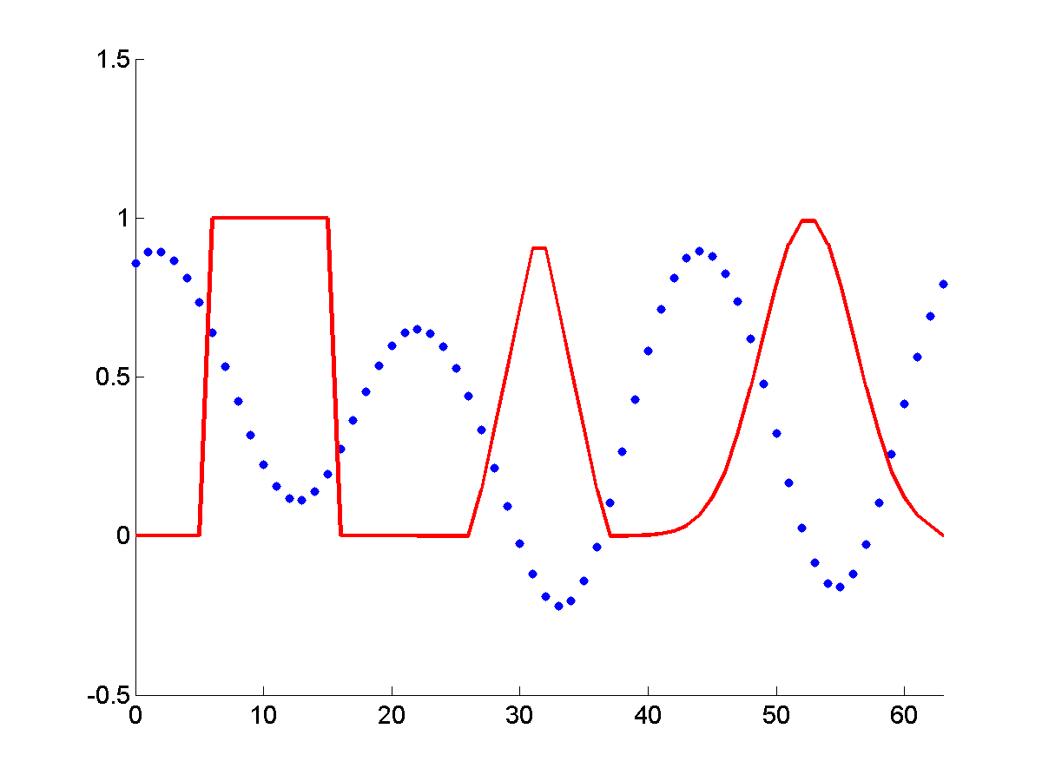
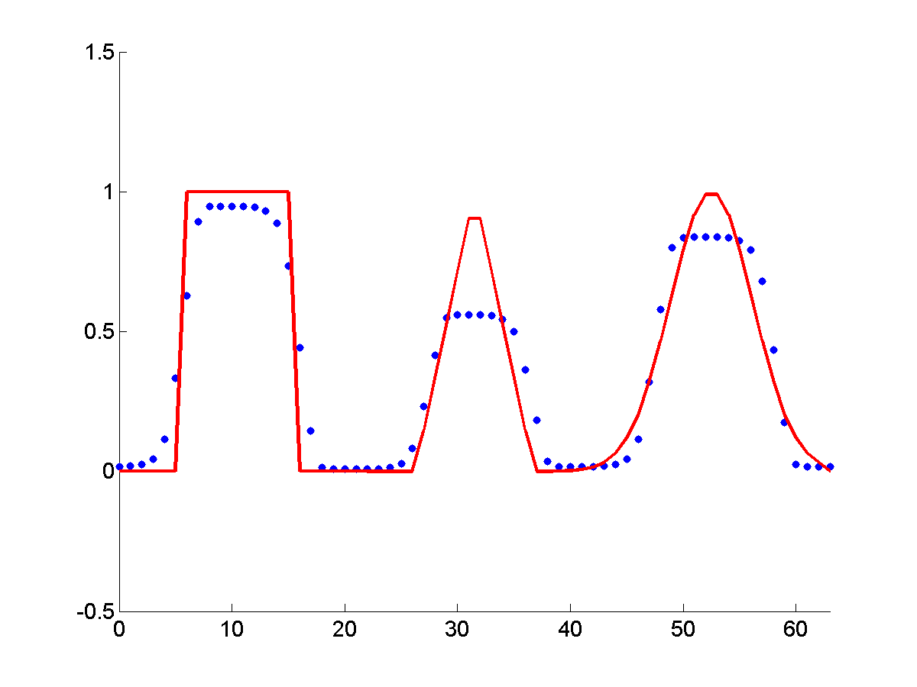
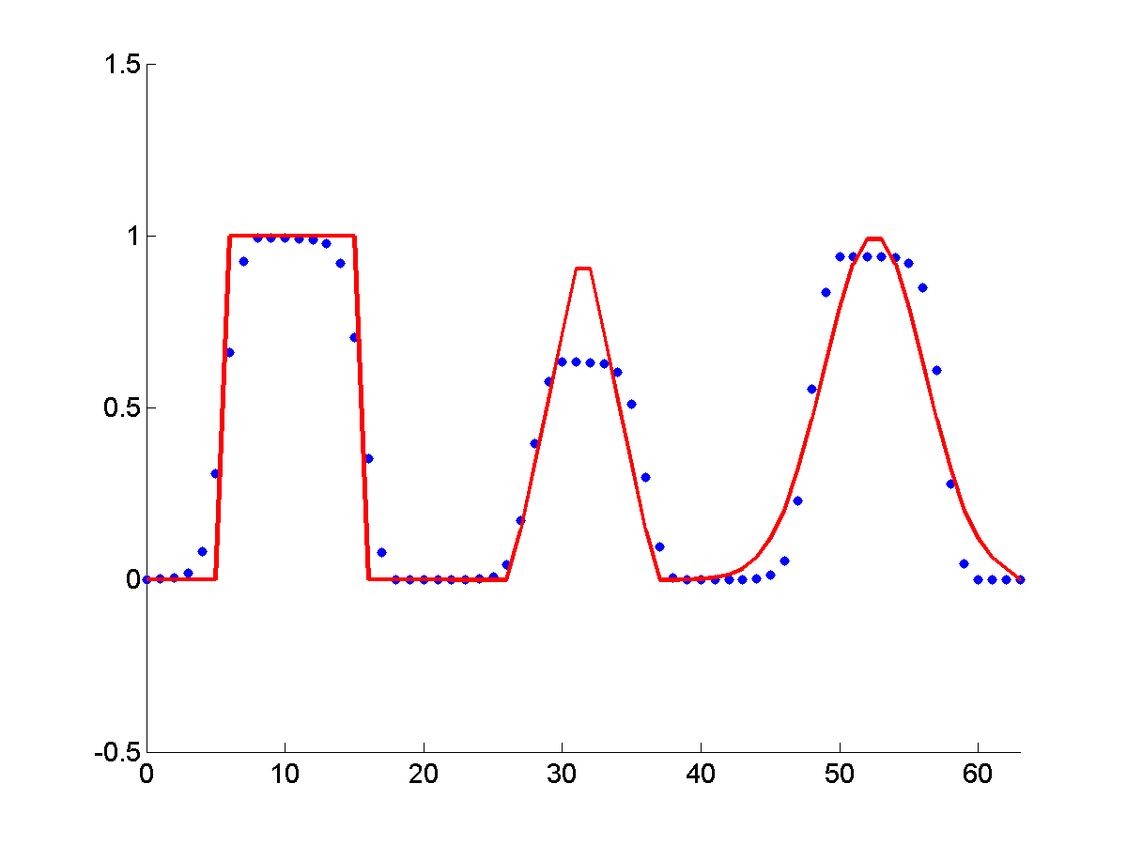
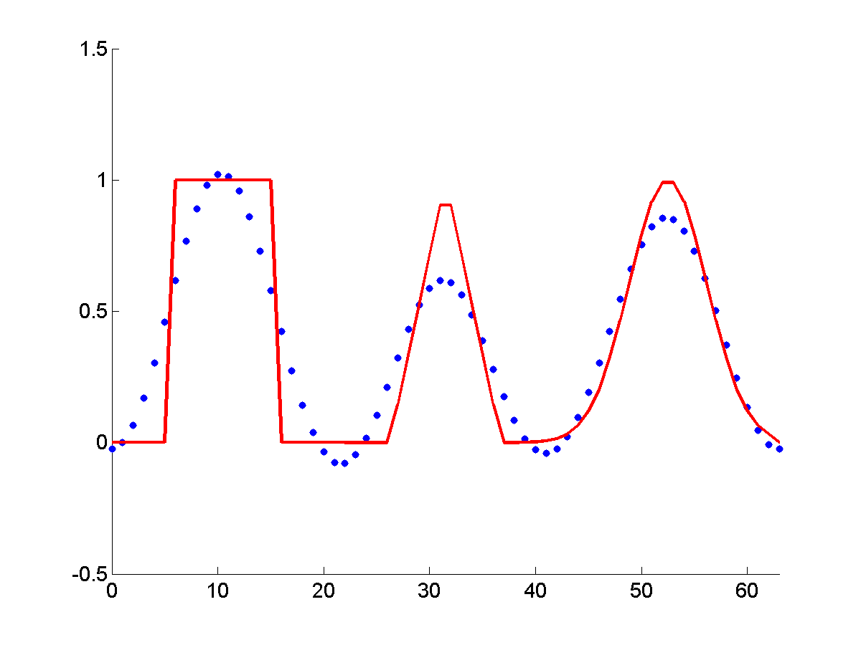
Results for 1D Advection in a 2D Code after 10 Periods
Lax-Wendroff (not TVD):
Lax-Wendroff (Superbee):
MUSCL:
SUPG:
Notes:
Only show the last column.

Slide 15
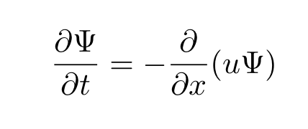
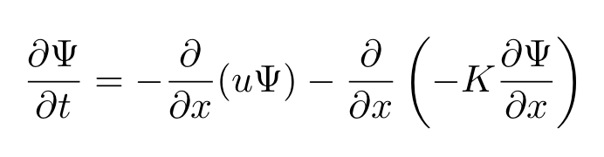
Multidimensional Positive Definite Advection Transport Algorithm (MPDATA)
A donor-cell approximation is defined in terms of the local Courant number
Adds a diffusive convective flux
Subtract out added dissipation using an antidiffusive velocity
As an example, the 1D advection equation,
becomes,
Notes:
Using a modified equation analysis.

Slide 16
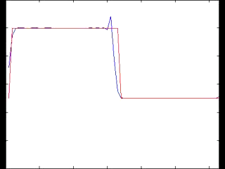
MPDATA
Antidiffusive correction to the donor cell method causes oscillations
PRELIMINARY

Slide 17
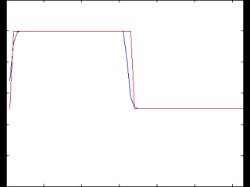
MPDATA
A Flux Corrected Transport (FCT) algorithm can correct the oscillations
Performing additional local corrective iterations increases the order of accuracy of the solution
PRELIMINARY

Slide 18
GPUs at a glance
Much higher FLOPS (floating points operations per second) per dollar than CPUs.
Different architecture from a CPU.
Many low throughput processing units
Cores share global memory
Warps/Wavefronts – groups of cores run same code.
Must use a language compiled for GPU
OpenCL – Open programming language for multiple CPUs (on same node) and GPU.
CUDA – Nvidia only.
This Project: OpenCL

Slide 19
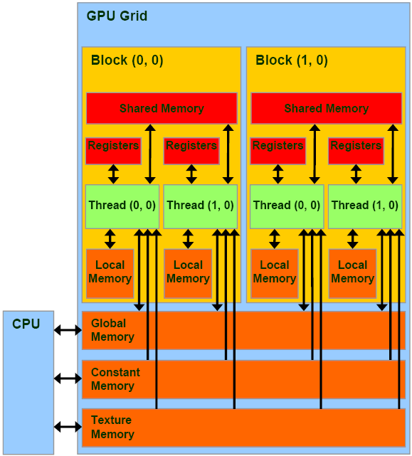
GPU architecture
http://www.realworldtech.com/gt200/3/

Slide 20
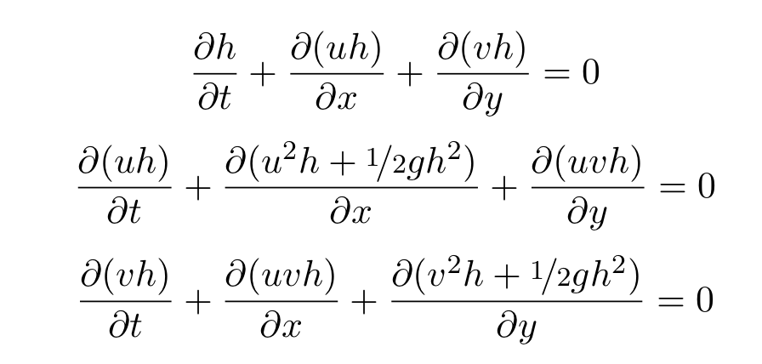
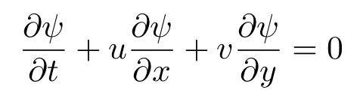
Shallow Water Equations
Simplification of the Euler Equations
Uniform Fluid Density
Wavelengths are much longer than fluid depth
Inert Tracer Equation
Notes:
Talk about the simplifications and that the tracer equation is simply an advection equation.

Slide 21
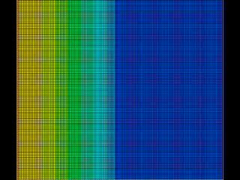
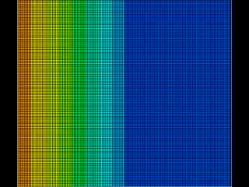
Shallow Water Simulations on the GPU
Fluid Height
Inert Tracer Concentration

Slide 22
Future Directions
FEM approach for full Euler equations
Implement more of these schemes in the GPU code
Develop full Euler Equation solvers with some of these schemes
Alternative numerical methods (WENO, Discontinuous Galerkin, etc.)

Slide 23
Question, Comments, Suggestions?

